Slide 1

Activation Functions
Presented by:
Elizer Ponio Jr.
Department of Computer Science
College of Computing and Information Technologies

Slide 2
Outline
What is an Activation Function?
Why do we use an Activation Function?
Types of Activation Functions

Slide 3
What is an Activation Function?
The activation function of a node in an artificial neural network is a function that calculates the output of the node based on its individual inputs and their weights.
Activation functions apply a non-linear transformation and decide whether a neuron should be activated or not

Slide 4

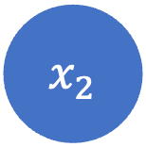

$${ x}_{1}$$
Activation function
$${Input: x}_{1},x_{2}$$
Activation function
$${ x}_{2}$$
Activation function
Input Layer
Hidden Layer
Output Layer

Slide 5





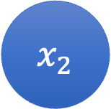



$$Weights: w_{11},w_{12} ,w_{21},w_{22},w_{3},w_{4}$$
$${ x}_{1}$$
$$w_{11}$$
Activation function
$$w_{3}$$
$$w_{12}$$
Activation function
$$w_{21}$$
$$w_{4}$$
$${ x}_{2}$$
$$w_{22}$$
Activation function
Input Layer
Hidden Layer
Output Layer

Slide 6




$$b$$
$$b_{1}$$
$$z_{1}$$
$${ x}_{1}$$
$$w_{11}$$
Activation function
$$z_{1}= w_{11} x_{1}+w_{21} x_{2}+b_{1}$$
We apply linear transformation where it multiplies the inputs with some weights (w) and add some bias (b)
Activation function
$$w_{21}$$
$${ x}_{2}$$
Activation function
Input Layer
Hidden Layer
Output Layer
Notes:
All hidden layers consists of neurons and each neuron we apply a linear transformation

Slide 7



$$b$$
$$z_{1}$$
$$b_{2}$$
$${ x}_{1}$$
Activation function
$$w_{12}$$
Activation function
$$z_{2}$$
$${ x}_{2}$$
Activation function
$$z_{2}= w_{12} x_{1}+w_{22} x_{2}+b_{2}$$
$$w_{22}$$
We apply linear transformation where it multiplies the inputs with some weights (w) and add some bias (b)
Input Layer
Hidden Layer
Output Layer
CCDEPLRL

Slide 8
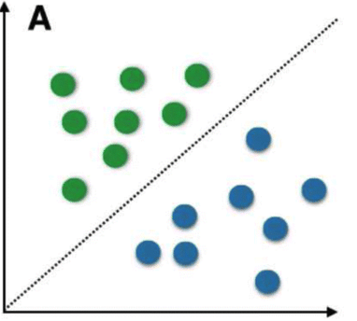
Linear Data
With linear data, we can model the predictions with a linear function
CCDEPLRL

Slide 9
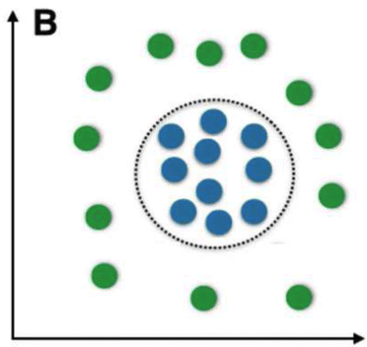
Non-Linear Data
If we have a more complex problem, a linear function cannot learn complex patterns
CCDEPLRL

Slide 10
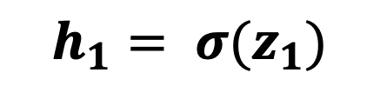

$$b$$
$$b_{1}$$
$$z_{1}$$
$$b_{2}$$
$${ x}_{1}$$
$$w_{11}$$
Activation function
$$h_{1}$$
$$h_{1}= σ(z_{1})$$
$$w_{12}$$
Activation function
$$w_{21}$$
$$z_{2}$$
$${ x}_{2}$$
Activation function
$$w_{22}$$
Input Layer
Hidden Layer
Output Layer
CCDEPLRL

Slide 11



$$b$$
$$b_{1}$$
$$z_{1}$$
$$b_{2}$$
$${ x}_{1}$$
$$w_{11}$$
Activation function
$$h_{1}$$
$$h_{2}= σ(z_{2})$$
$$w_{12}$$
Activation function
$$w_{21}$$
$$z_{2}$$
$${ x}_{2}$$
Activation function
$$h_{2}$$
$$w_{22}$$
Input Layer
Hidden Layer
Output Layer

Slide 12
Different Activation Functions
Sigmoid Function
TanH
ReLU
Softmax

Slide 13
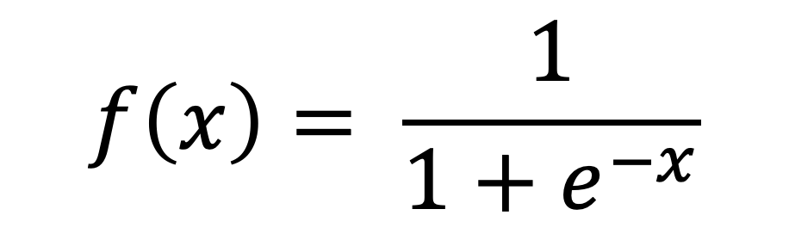
Sigmoid
$$f\left(x\right)= \frac{1}{1+e^{−x}}$$
Outputs a probability between 0 and 1
If the input is a very negative number, sigmoid outputs a number close to 0
If the input is a very positive number, sigmoid transforms it to a number close to 1
The more the positive the input number is, the more our neuron will be activated.

Slide 14
When to use Sigmoid?
Sometimes used in hidden layers.
Most of the time, it is used in the last layer for binary classification problems.

Slide 15
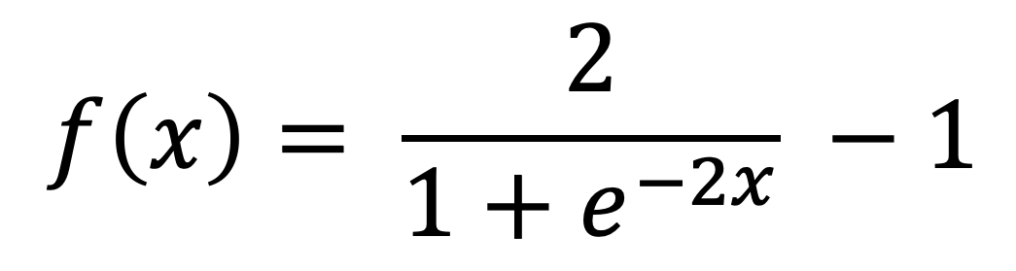
TanH (Hyperbolic Tangent)
$$f\left(x\right)= \frac{2}{1+e^{−2x}} −1$$
Basically a scaled and shifted sigmoid function
Outputs a number between -1 and +1

Slide 16
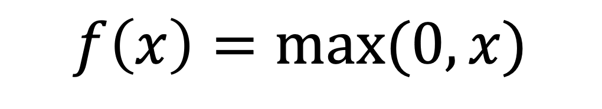
Rectified Linear Unit (ReLU)
$$f\left(x\right)=max⁡(0,x)$$
Most popular choice for hidden layers
It takes the maximum of 0 and input x
If the input is negative, it outputs 0.
If the input is positive, it simply returns it without modification.

Slide 17
When to use ReLU?
The rule of thumb is if you are not sure which activation function to use in your hidden layers then just use ReLU.

Slide 18
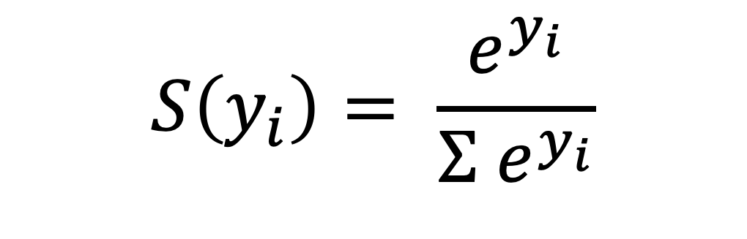
Softmax
$$S\left(y_{i}\right)= \frac{e^{y_{i}}}{{Σ e}^{y_{i}}}$$
Transforms the input to output a probability number between 0 and 1
The higher the input number, the higher will be the probability value

Slide 19

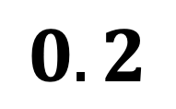

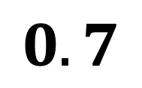

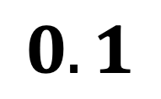
Softmax
$$5$$
Softmax
$$0.7$$
$$3$$
Softmax
$$0.2$$
$$1$$
Softmax
$$0.1$$

Slide 20
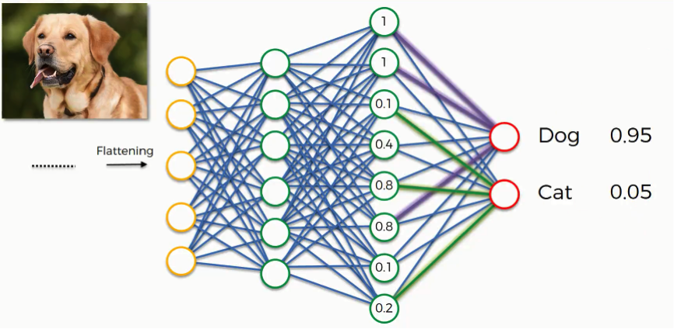
When to use Softmax?
It is usually used in the last layer in multi-class classification problems
Softmax decides for the class with the highest probability

